Slide 1
Effects of future changes in SOx, NOx and ammonia emissions on secondary inorganic aerosols and nitrogen depositions
Jan Eiof Jonson¹, Hilde Fagerli¹, Thomas Scheuschner² and Svetlana Tsyro¹
¹Norwegian Meteorological Institute
²Umweltbundesamt, Dessau-Roßlau Germany

Slide 2
PM_{2.5} is causing health problems in Europe. Emissions of PM_{2.5} precursors SOx, NOx are decreasing, but at the same time Europe is struggling to meet the (even modest) reduction targets for ammonia. To what extent will a lack of success (or ambitions) in reducing ammonia emissions prevent a faster decline in European PM_{2.5} levels?
Why ammonia?
Nitrogen depositions In more than 60% of European ecosystem areas the exceedance of critical loads for eutrophication is exceeded in 2017 and 2018. To what extent will a lack of success (or ambitions) in reducing ammonia emissions prevent a faster decline in the exceedances of eutrophication in Europe?

Slide 3
Model runs for Europe
Model resolution 0.1 x 0.1 degrees
Emissions:
Base 2005: EU28 official EMEP emissions. All other countries/regions Eclipse version 6a 2005 emissions.
Base 2017 Official EMEP emissions.
Base 2030 EU28 2005 official EMEP emissions scaled according to NED2030 obligations. All other countries/regions Eclipse version 6a 2030 emissions.
In addition model trend runs 2005 -- 2017.
In addition several sensitivity runs reducing ammonia, NOx and SOx emissions in 10% percent steps. For 2030 ammonia emissions the stepwise reductions have been made between Base and 50% reductions.

Slide 4
EU28 Emissions of SOx (as SO₂),
NOx (as NO₂) and ammonia (as NH₃)
Numbers are percentage changes relative to 2005
EU28 SIA25 concentration split by component
Numbers represent percentage contribution to
SIA
 | 2005 | 2011 | 2017 | 2030
SOx | 100% | -47% | -70% | -81%
NOx | 100% | -25% | -38% | -67%
NH3 | 100% | -7% | -4% | -30%
 | 2005 | 2011 | 2017 | 2030
Sulphate | 40% | 37% | 27% | 36%
Nitrate | 35% | 39% | 41% | 41%
Ammonium | 24% | 25% | 24% | 23%
Note that the the percentage contribution from ammonia remains at 23 - 25% even though ammonia emissions have changed far less sulphur and NOx

Slide 5
Measured and model calculated trends in NH₄
(and SO₄²⁻ and NO₃⁻)
EIONET Report – ETC/ATNI 2020/8

Slide 6
Ammonia trends from satellite 2008 - 2018
Overall Worldwide increase 2008 - 2018: 12.8%
Western and Southern Europe:
1.9% per year.
But how representative are 2008 and 2018 for Europe?
Damme, M. V., Clarisse, L., Franco, B., Sutton, M. A., Erisman, J. W., Kruit, R. W., van Zanten, M., Whitburn, S., Hadji-Lazaro, J., Hurtmans,D., Clerbaux, C., and Coheur, P.-F.: Global, regional and national trends of atmospheric ammonia derived from a decadal (2008-2018)satellite record, Environmental Research Letters, http://iopscience.iop.org/article/10.1088/1748-9326/abd5e0, 2020

Slide 7
Effects of additional reductions in 2005 and 2030 NH₃ emissions in the EU28 countries calculated in 10% increments for ammonia.
Base - 2030 target emissions
10% - Base - Effects of additional 10% reductions relative to Base in 2030
50% - 40% - Effects of additional 10% reductions when already reduced by 40% relative to Base.
The reductions in PM 2.5 in ngNm⁻³ per Gg ammonia (as NH₃) emitted are given in brackets.
Note that the PM_{2.5} reductions per Gg NH₃ emitted are much lower in 2030 compared to 2005 and that reductions are largest in winter. and small in summer.
Season | PM2.5 μgm⁻³ | 10% - Base μgm⁻³ | 40% - 50% μgm⁻³
2005 Annual | 8.87 | -0.22 (0.61)
2030 Annual | 4.45 | -0.066 (0.23) | -0.103 (0.35)
2030 Winter | 5.31 | -0.126 (0.44) | -0.202 (0.70)
2030 Summer | 4.23 | -0.015 (0.05) | -0.018 (0.07)

Slide 8
Effects on PM2.5 of a 10% cut in ammonia emissions by season in 2030
Most of the effects are in Winter. Hardly any effects in summer

Slide 9
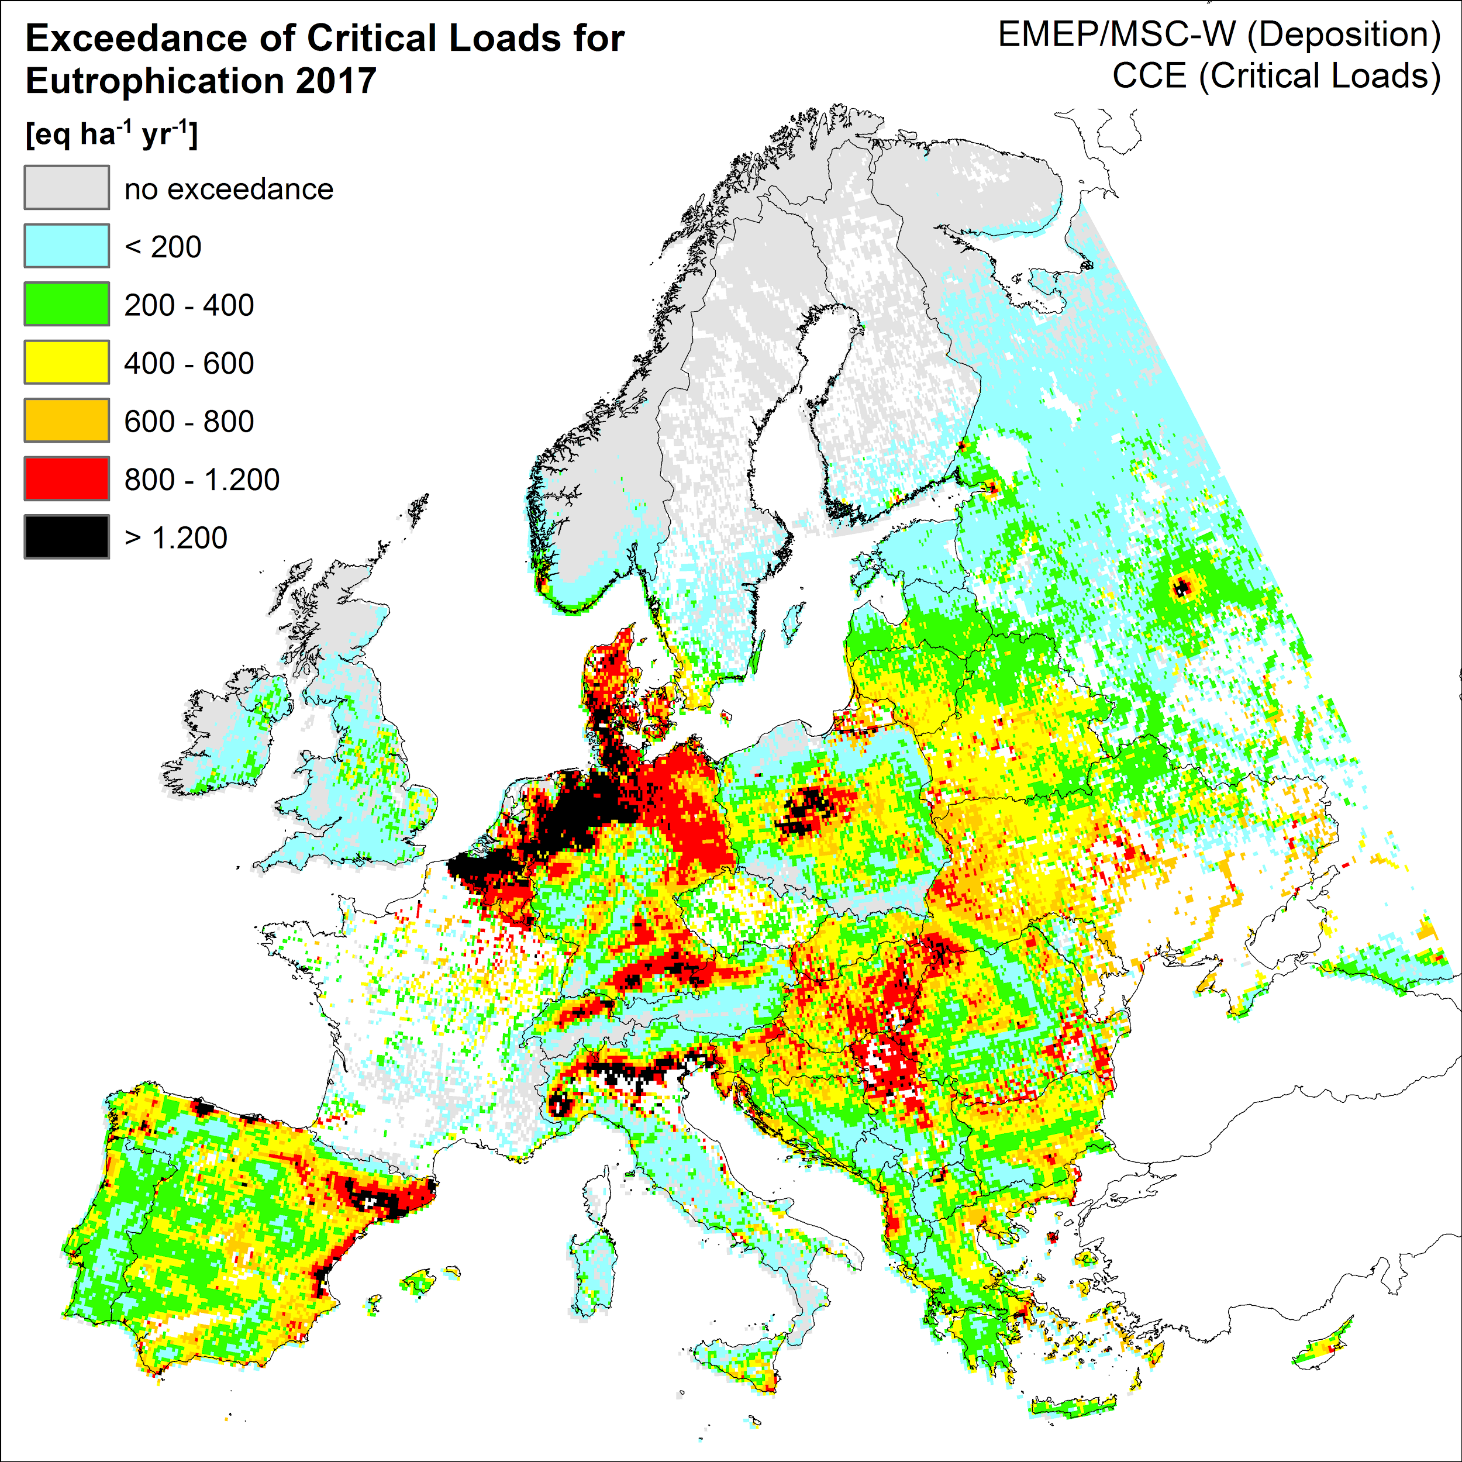
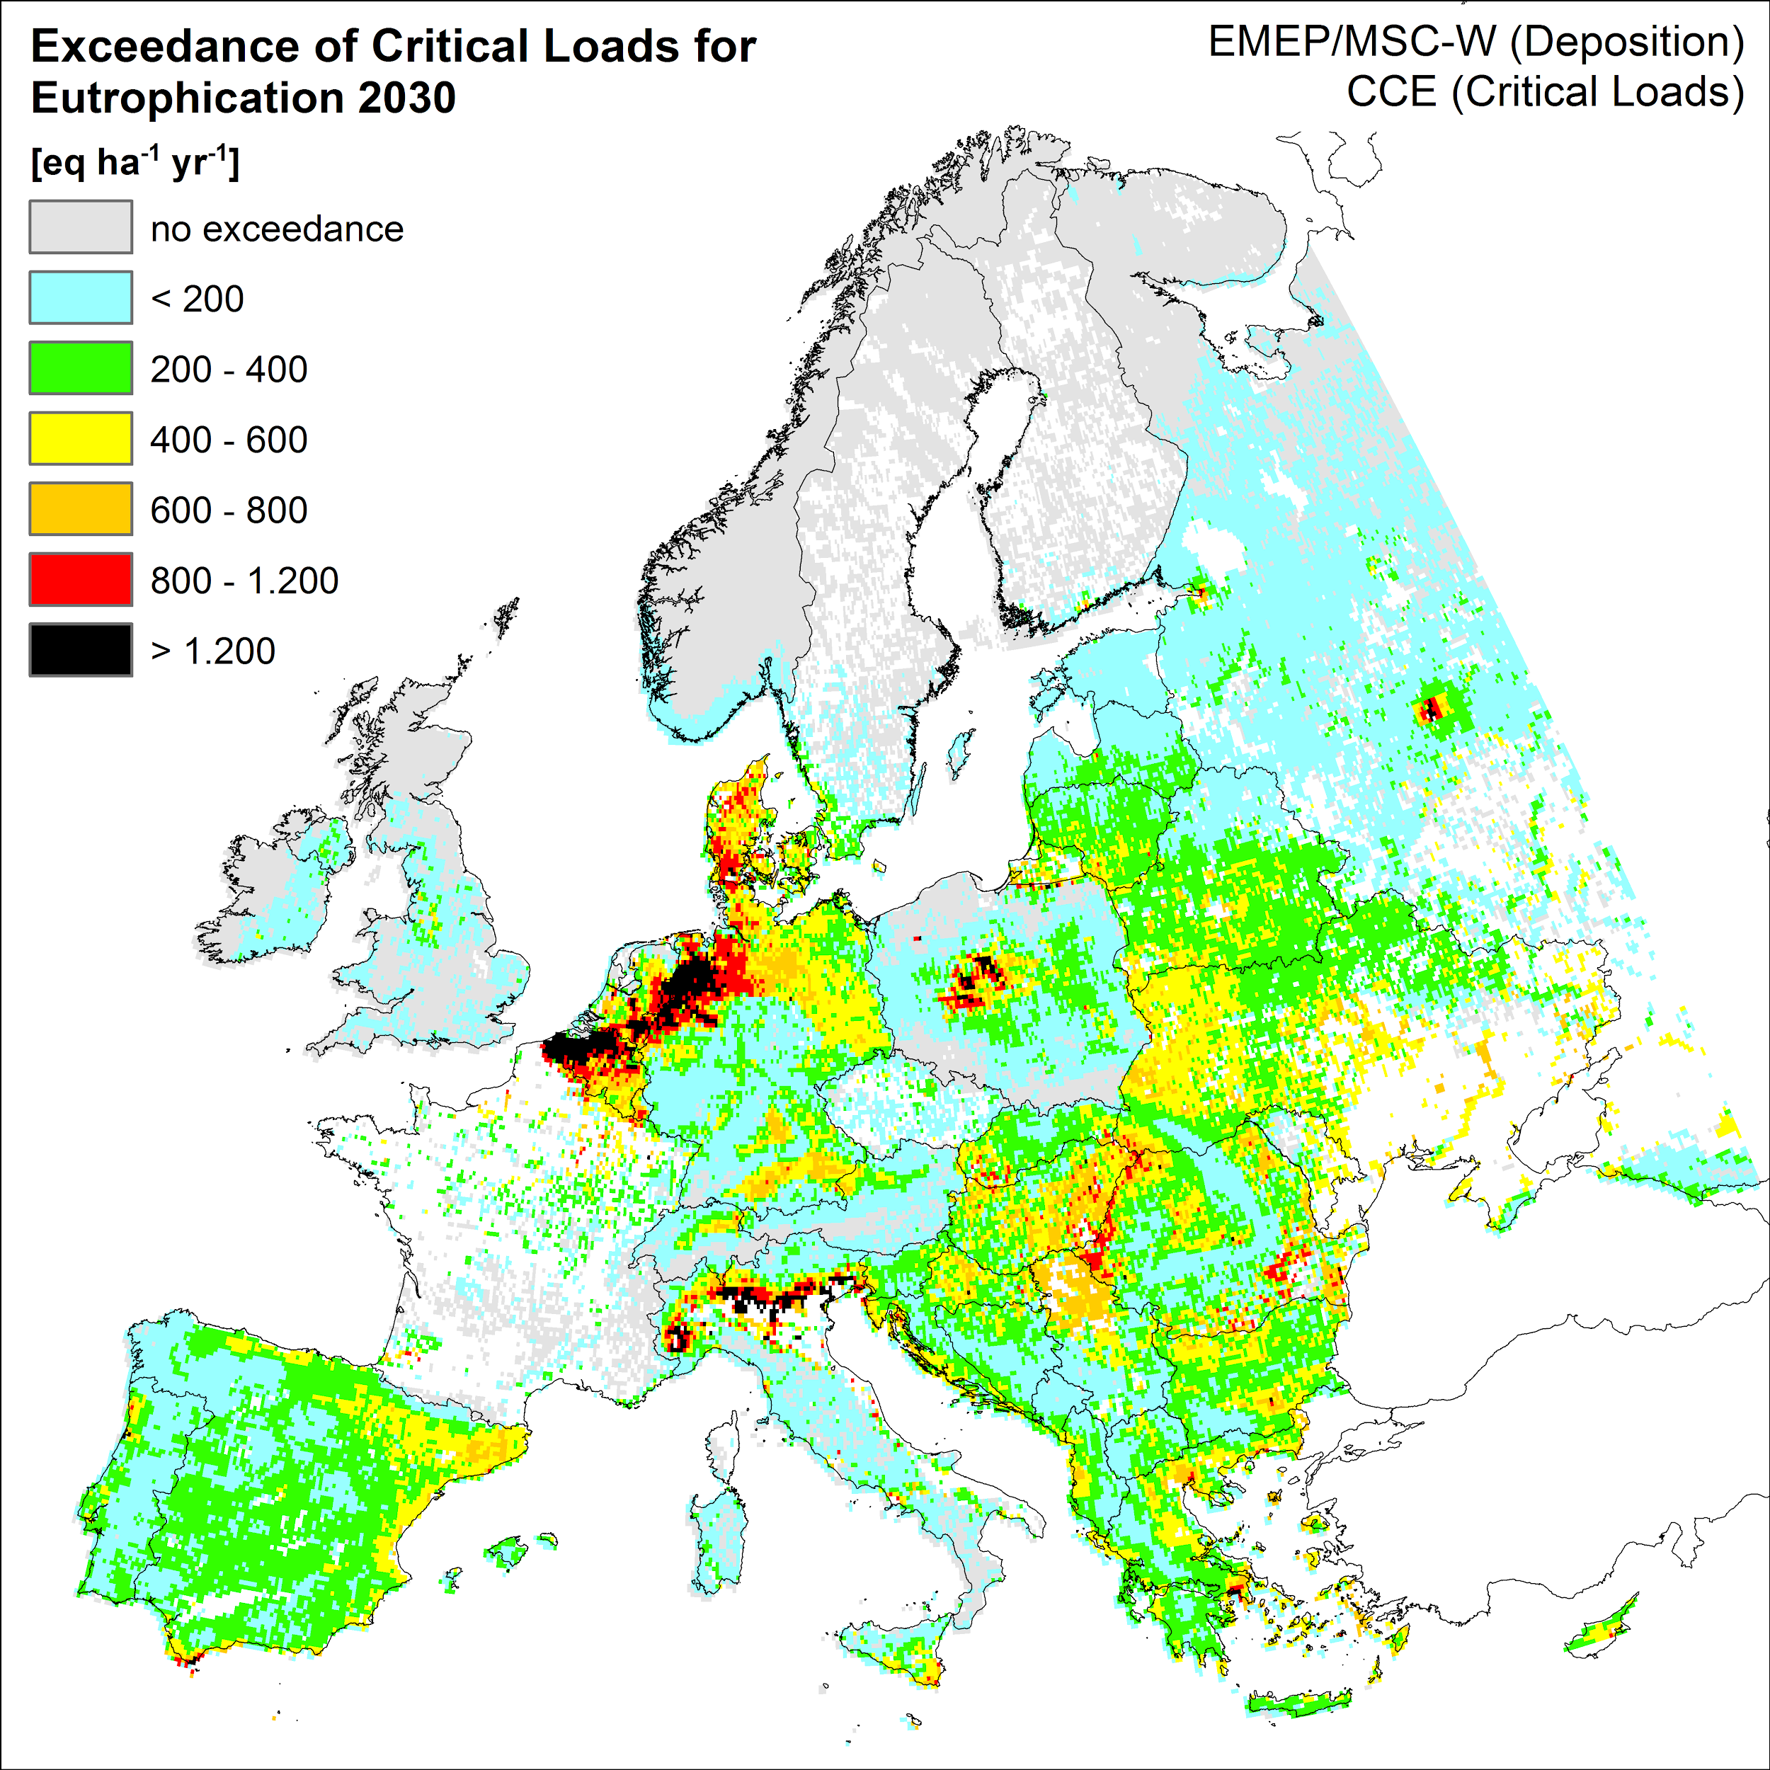
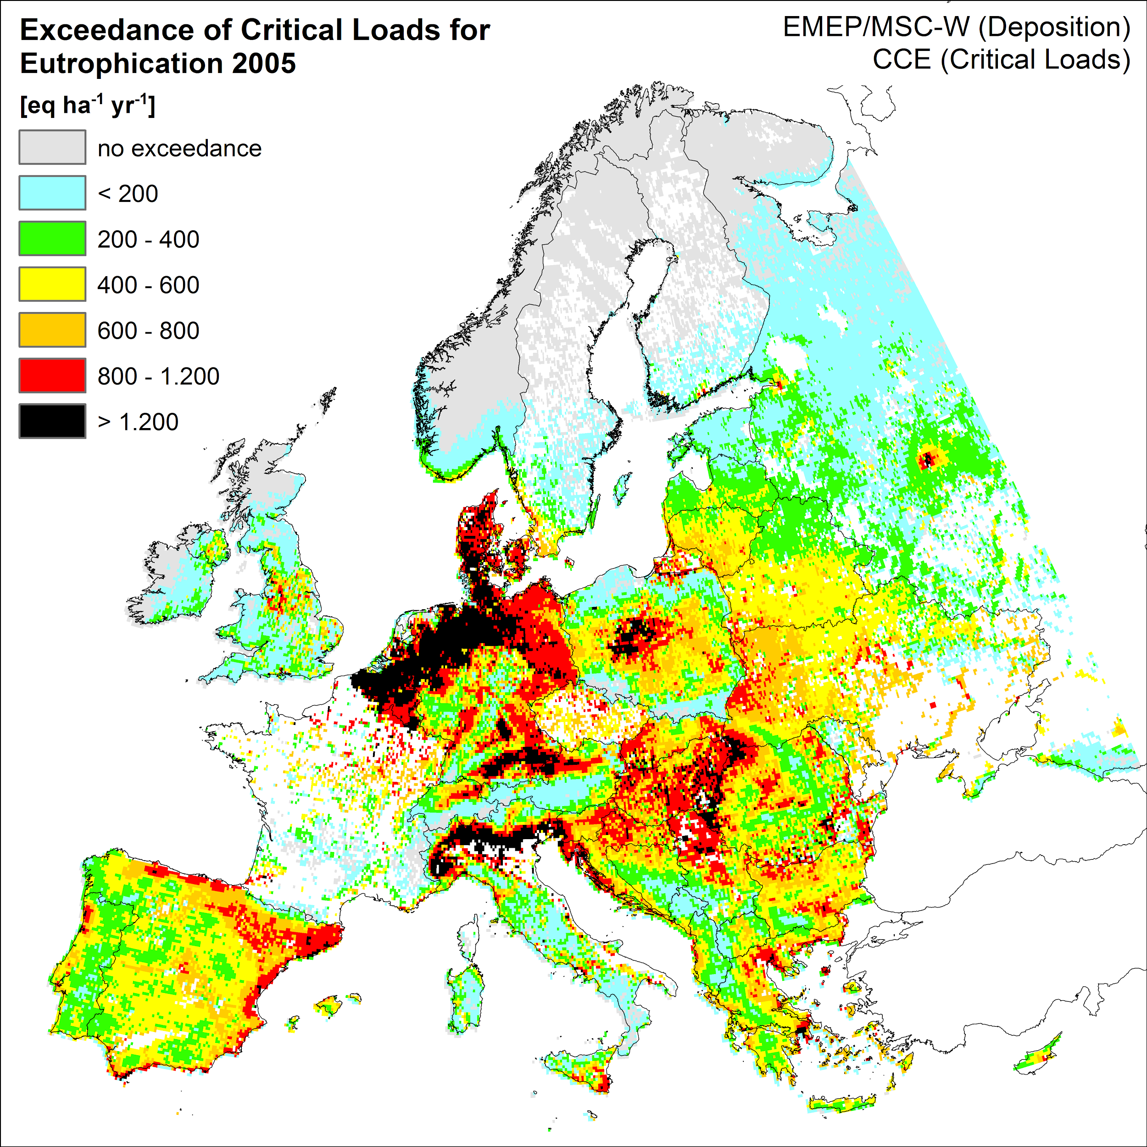
Calculated exceedances of critical loads for eutrophication (eq ha⁻¹y⁻¹)
in 2005, 2017 and 2030.
Eutrophication is decreasing. 2005 - 2017 - 2030.
But exceendaces in most of Europe also in 2030

Slide 10
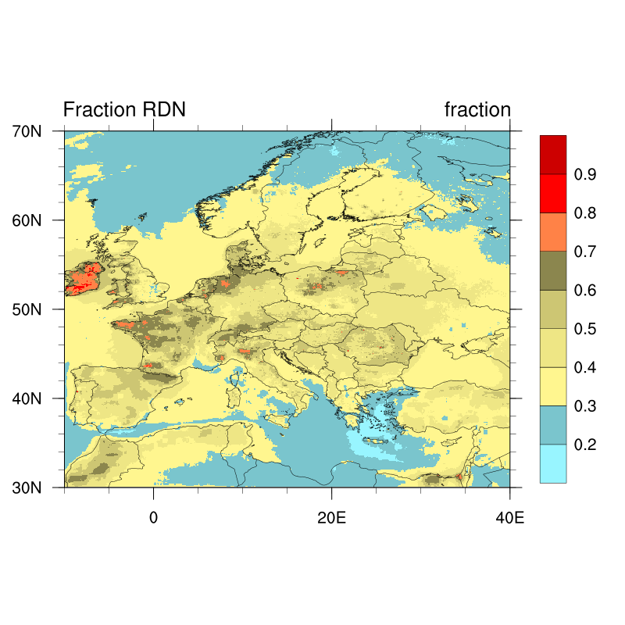
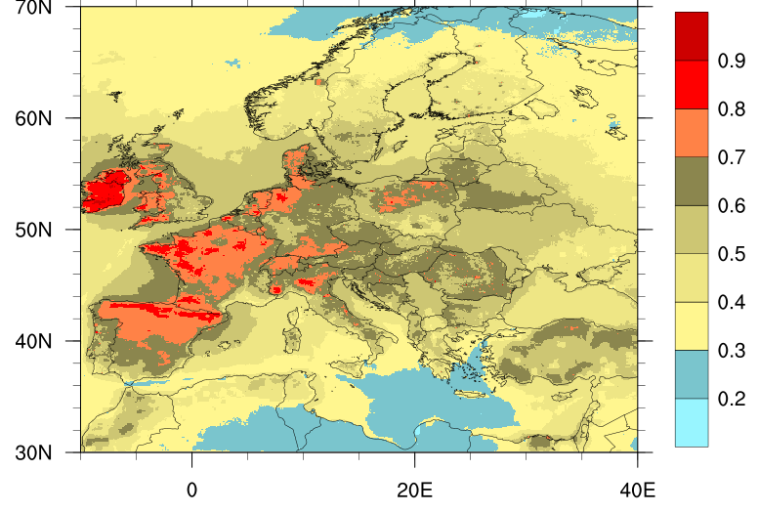
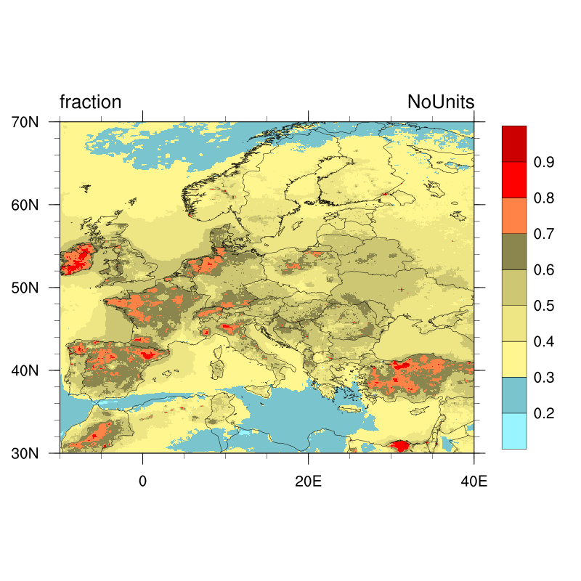
Fraction of nitrogen deposited as reduced nitrogen
In large parts of Europe more than 70% of the total deposition of N in 2030 is reduced nitrogen.
2005
2030
2017

Slide 11
Points to consider for PM_{2.5}
The ratio of ammonia to sulphate and HNO₃ in the European atmosphere has increased in past decades, and with the projected emission trends this ratio will continue to increase. As an annual average we find that the efficiency of mitigating PM_{2.5} concentrations by reducing ammonia emissions by 10% will be reduced by a factor 2.6, from 0.61 to 0.22 ngNm −3 per Gg ammonia emitted between 2005 and 2030
However
Ammonia emission from agriculture differ by season with a minimum in winter. As a result the ratio of ammonia to sulphate and HNO₃ is much higher in winter, and a much larger portion of the ammonia will form ammonium particles.
Emissions of ammonia on one hand, and SOx and NOx on the other hand, differ in space and time. Even if there is a large surplus of ammonia over SOx and NOx on a European scale, this may not always be the case locally, in particular in urban areas with little nearby agricultural activity. Advection of NH₃ rich air into urban areas may cause PM_{2.5} episodes.

Slide 12
Points to consider for nitrogen deposition and eutrophication
Depositions of nitrogen are decreasing in Europe.
This decrease is mainly a result of reductions in NOx emission. As a result the fraction of reduced N in the total N deposition is increasing and may reach 70% in large parts of Europe by 2030.
Exceedances for critical loads of nitrogen deposition are projected in large parts of Europe also in 2030, and reductions in ammonia emissions are needed in order to minimize damage to ecosystems.

